Slide 1


Marketing Analytics
Lecture 3 Transaction Analytics (I)
Dr. Bingqing Xiong
Senior Lecturer in Deakin Business School

Slide 2

Learning Objectives for Transaction Analytics
Understand how to assess and characterize purchase dynamics
Segmentation; RFM analysis
Know how to perform relevant analysis and interpret the results – will be in next week

Slide 3
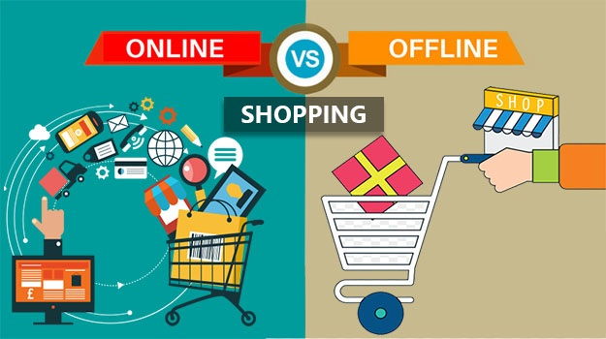
What is Transaction Data
The time of purchase
The location where it took place
What digital channel or physical touchpoint was used
The payment method
Whether any discounts or promotions were used
If the purchase came from a repeat customer or loyalty member

Slide 4
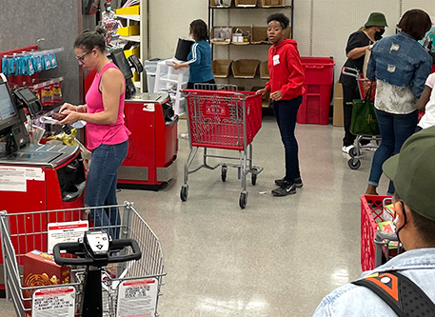
Transaction Data: POS in offline stores
POS - Point-of-Sale Systems
The POS collects
date and time
items purchased
price of each item
payment method used
applicable taxes or fees
Some customer information
Offline Store: Manual record-keeping, barcode scanners and mobile payment systems are also used.

Slide 5
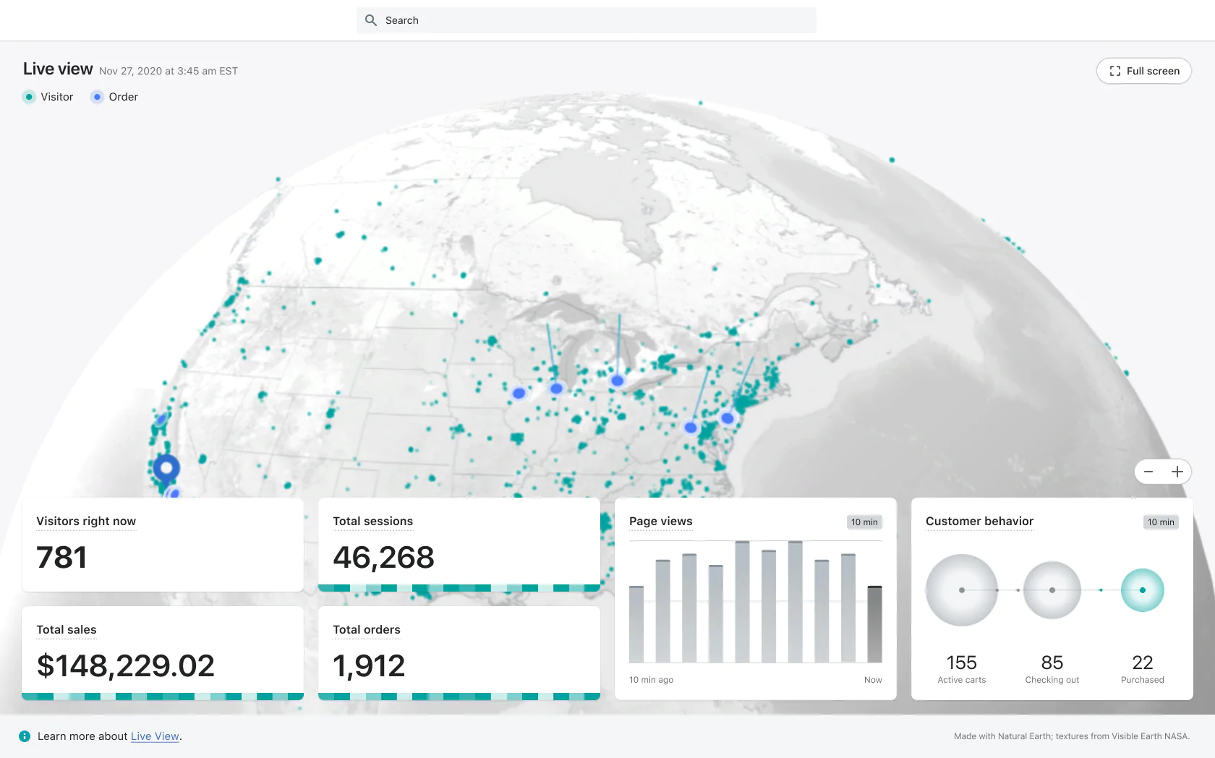
Live View from Shopify (an e-commerce platform)
Visitors
Sales
Checkout
Metrics
Traffic

Slide 6
The Role of Transaction Data
Transaction and purchase data is useful for predicting sales
Can also be used to reflect and/or understand the emotional or cognitive factors influencing customer behaviour
Identifying meaningful and significant tendencies and characteristics in the data

Slide 7
Analysis of Transactions on Individual Level
Dynamics of Individual Transaction Data
Loyalty
  Purchase behaviour → Dynamics of repeat purchase (e.g., frequency)
  Attachment → Emotional bonds to a brand (e.g., sentiment from the review)
Habit
  Purchase behaviour → Frequency + Routine (e.g., Time/Space)
Variety Seeking
  Product switching
  Variance of products

Slide 8
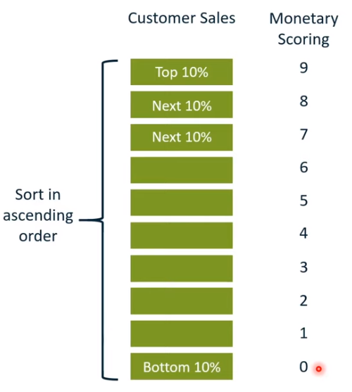
Analysis of Transactions on Individual Level
Recency, Frequency, Monetary (RFM) Analysis
        Recency: How recent was the customer’s last purchase?
        Frequency: How often did this customer make a purchase in a given period?
        Monetary: How much money did this customer spend in a given period
  Consumers can be given a score according to the actual value or be assigned to quartiles of groups based on their scores

Slide 9
Analysis of Transactions on Individual Level
Recency, Frequency, Monetary (RFM) Analysis
      Consumers who rank highly in RFM are more likely to be repeat buyers
      RFM scores can then be cross-referenced with other variables (e.g., demographics)
      RFM can also be about other behaviours, and may set alert of customer churning
      However, each business has different interpretations of what a good recency score is
      Provide your RFM criteria is important as it varies in different contexts

Slide 10
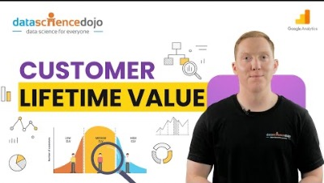
Analysis of Transactions on Individual Level
Customer Lifetime Value (CLV)

Slide 11
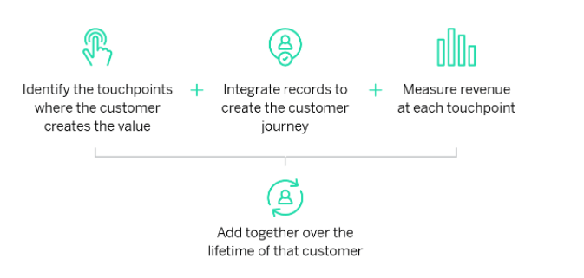
Analysis of Transactions on Individual Level
Customer Lifetime Value (CLV)
    Extends the logic of RFM
    Measure show valuable a customer is to the company, not just on a purchase-by-purchase basis but across the whole relationship
    The actual formula vary from company to company and from market to market (Customer lifetime value formula: Easy ways to calculate it)

Slide 12
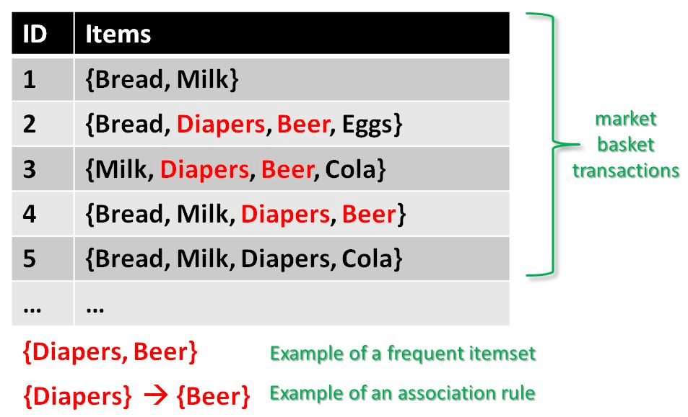
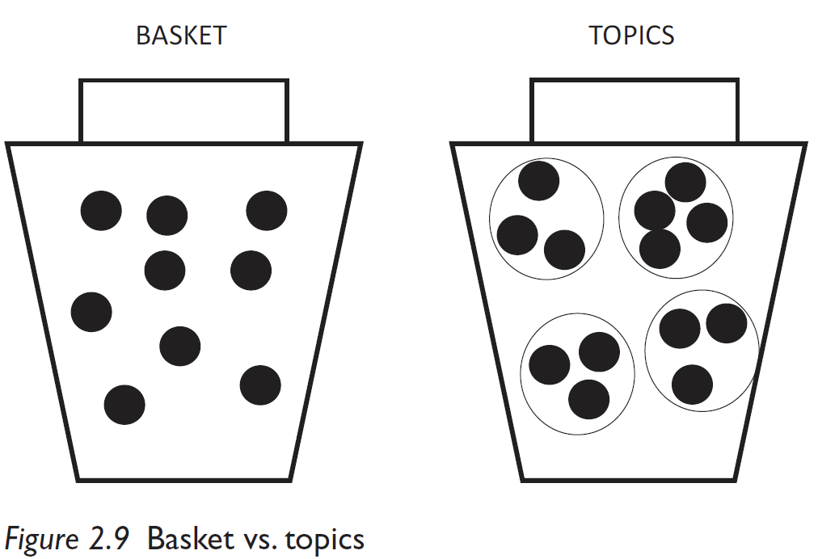
Analysis of Transactions on Individual Level
Basket Analysis
    Which products are brought together?
    Associate products bought at the same time (by the same purchaser)
Source: Andrew Smith (2009) Consumer Behaviour and Analytics, Routledge.

Slide 13
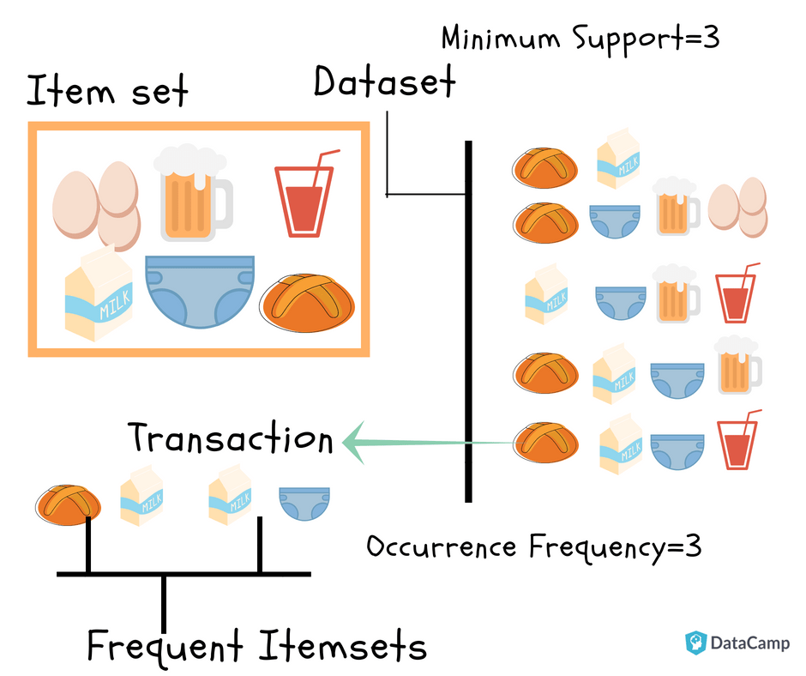
Analysis of Transactions on Individual Level
Basket Analysis
    Itemset: Collection of one or more items.
    Support Count: Frequency of occurrence of an item-set
    Support(s): Fraction of transactions that contain the itemset X
    Bread & Milk vs. Diapers & Milk
Source: Andrew Smith (2009) Consumer Behaviour and Analytics, Routledge.

Slide 14
Analysis of Transactions on Aggregate Level
Frequency & Proportion
Central Tendency
Dispersion
Segmentation

Slide 15
Describing Frequency & Proportion
Count
Percentage

Slide 16
Measure of Central Tendency
Mode
The most frequently occurring value.
If more than one score occurs most frequently then all values should be reported.
Median
Central value of a set of scores (i.e. has as many scores above it as below it).
NB： if there are an even number of scores then the median is half way between the two middle points.
Mean
Sum of all the scores divided by the number of scores

Slide 17
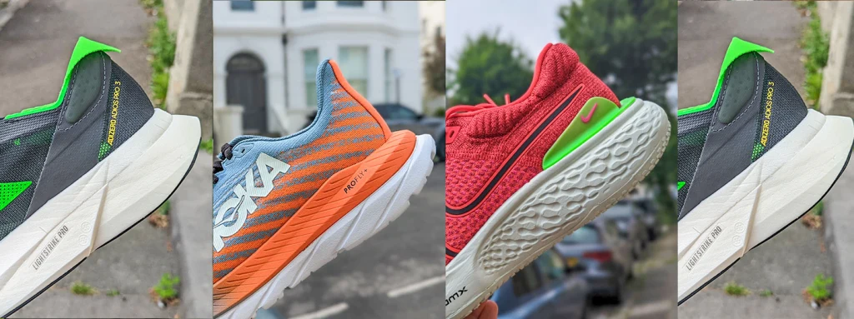
Measure of Dispersion
$70 - $100
Range
Range = Maximum value - Minimum value
This value is sensitive only to the two extreme values in a data set, and provides no information about the variability of the scores in between - so, if one data point is unusually large or small (i.e. an outlier) then the picture of the data set as a whole could be distorted.
Outlier = a value which is unusually extreme

Slide 18
Measure of Dispersion
Variance
The variance (S2) is a value which takes account of each of the scores in a sample, and looks at the difference between each of those scores and the mean.
The formula used to calculate the variance is:
But this can be cumbersome to calculate, so an easier way is to use the formula:
The variance describes the amount of spread of a data sample. The larger the spread of the data the larger the variance
, x = mean, N = number of observations

Slide 19
Measure of Dispersion
Variance
The value (N-1) is used so that data obtained from a sample can be approximated to the value of the population variance.
If only the sample variance was required, then (N) would be substituted for (N-1).
However, sample variance value is only useful for describing the data and is not as useful or rigorous as the population approximation value, and therefore when we mention the variance or any formula requiring the variance without other specification, then the two equations in the previous slide should be used.

Slide 20
Measure of Dispersion
Standard Deviation
The variance uses a squared value, so the numbers obtained are high and not so useful.
Therefore it is more appropriate to refer to the Standard Deviation (S or SD), which is the square root of the variance:
Or
(N-1) is used to make an estimate of the population SD on the basis of information from a sample.
Standard deviation serves as the indication of how the values of a variable are spread around the mean and the indication of the usefulness of the mean as typical value.

Slide 21

An Introduction to Market Segmentation

Slide 22
Segmentation
Businesses usually segment their customers using
      Demographic information (age, gender, income, education etc..)
      Geographical information (region, city, country)
      Psychographics (lifestyle, values, personality)
      Behavioural data (RFM, product usage)

Slide 23
Segmentation Using RFM
Steps:
1. Filter the dataset
2. Exam the dataset (data cleaning is necessary !!!)
3. Summarize the dataset
4. Put together the RFM Report
5. Interpreting the results
Note: Detailed instructions will be shared at Lab 4

Slide 24
Segmentation Using RFM
Interpreting the results
    Look at recency, frequency and monetary separately
              X, High F, X: frequent buyers – loyalty programmes
              X, X, High M: highest paying customers – premium offers, luxury products
              … …
    Taking these three aspects together
              High R, High F, High M: highly engaged customers – loyalty program, focusing on value-added offers
              … …

Slide 25
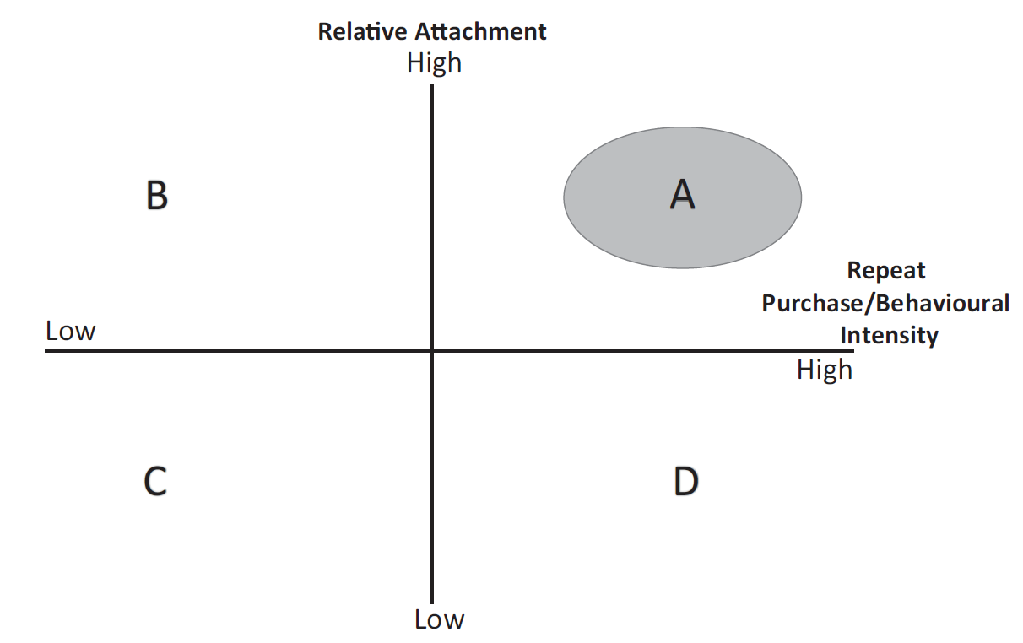
Manual Bivariate Segmentation/Two-Dimensional Segmentation
Pro: a useful technique for businesses that have limited resources or data analysis capabilities
Con: less precise than more advanced segmentation methods
Source: Andrew Smith (2009) Consumer Behaviour and Analytics, Routledge.

Slide 26
Manual Bivariate Segmentation
A - Composite loyal
      Consumers buy the product at relatively high rates of repeat purchase or intensity; positively attached to the product
B - Constrained loyal
      Consumers have positive attachment to the product, but this does not manifest in behaviour and purchase
C - Disloyal
      Consumers do not like or buy the product a great deal
D - Specious loyal
      Consumers do not like the product or brand buy buys it nonetheless
Source: Andrew Smith (2009) Consumer Behaviour and Analytics, Routledge.

Slide 27
Discussion
Reasons behind why specious loyal
Loyalty Programs/ Social Pressure/ Limited options
Notes:
https://www.menti.com/aldoveydr3o3

Slide 28
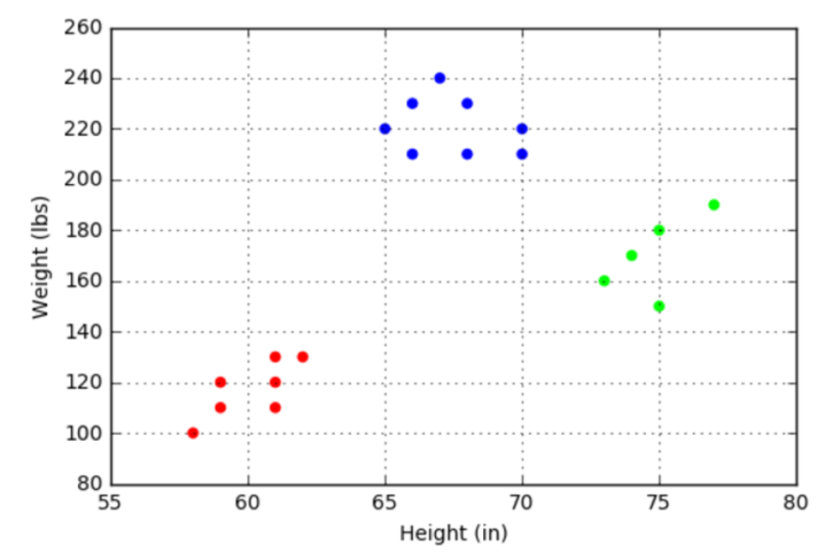
Segmentation by Scatter Plot
T-shirt company

Slide 29
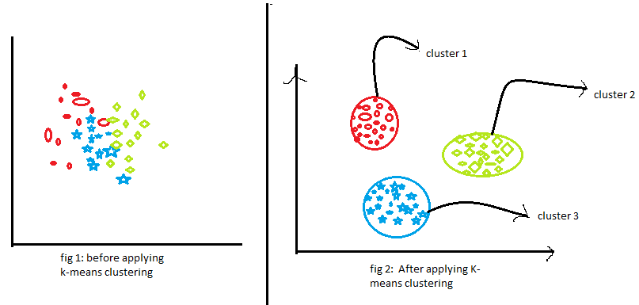
Clustering Analysis for Segmentation
Segment customers to achieve more effective customer marketing via personalization
K-means cluster analysis
    An unsupervised learning method that partitions the observations into a predefined number of non-overlapping clusters where observations within each cluster has the smallest sum of arithmetic mean
    Identifies clusters by minimizing the within-cluster difference
    To decide the number of clusters, can plot different number of clusters and the corresponding total within-cluster sum of squares, and choose the number of clusters where the sum of squares starts to level off
    Interpret each cluster by considering each cluster’s attributes

Slide 30
To be continued in the next week …
Transaction Data
Analysis Levels: Individuals & Aggregation
Segmentation

